Slide 1
Tracing of Information Flow in Social Network
Under the guidance of: By:
Ms. Ankita, Mr. Rishabh Kaushal Himani Sharma
01902052016
M.Tech-ISM

Slide 2
Problem Statement
The tracing information flow in Social Network is a cumbersome process. As large amount of data is unstructured and uncorrelated, which is available in multiple formats.
This work aims to solve the problem by connecting the unconnected dots in problem domain. It involves retrieval, pre-processing and analytics of social network database.
In order to identify, the original source of information. It can be determined how information diffusion occurs among followers and exhibit their interest.
Collection of data
Determination of origin
Impact of the model

Slide 3
Introduction
Online social networks allow users to produce and consume content on an unprecedented scale. Due to the impact of these networks on society, it is essential to extract valuable information from this huge amount of data.
Events, hazards, protest, rumours etc. spread and evolve very quickly in social networks. Therefore, their understanding, visualization, and prediction are becoming critical issue for both end-users and researchers.
In recent years, a variety of techniques and models developed to capture, analyse it, extract knowledge from it and predict information diffusion.
It is very common in real life that information distorts during the process of transmission in a social network, which may lead to people’s incorrect comprehension of the information and further poor decision making.

Slide 4
Why Twitter is being considered?
Twitter is a microblogging site with more than 300 million active users.
Around 500 tweets are generated daily.
There are three levels of permission available to applications:
read only
read and write
read, write and access Direct Messages
The amount of public data is very large.

Slide 5
Literature Survey
Twitter, a microblogging network has attracted many studies on its features, the quote tweet option, the follow prediction, and the interaction between the network topology and the users.[1],[6]
Various studies on information diffusion have been done. Weng et al. [5] examined how information diffusion caused the creation of new social links and reshaped the structure of microblogging system.
Dickens et al. [4] presented models of information flow based on the Independent Cascade Model to predict the probabilities of invisible flow on Twitter.
As online social networks become extremely popular in these days, people communicate and exchange information for various purposes. Rattanaritnont et al. [2] investigate patterns of information diffusion and behaviours of participating users in Twitter. That would be useful to verify the effectiveness of marketing and publicity campaigns.
Zhang et al. [3] relying on social big data, they focus on the analysis and control of information diffusion. Using on the two real-world datasets, they proposed two critical points are verified and analyzed. Our work may be beneficial in terms of analyzing and designing the information diffusion algorithms and relevant control strategies.

Slide 6
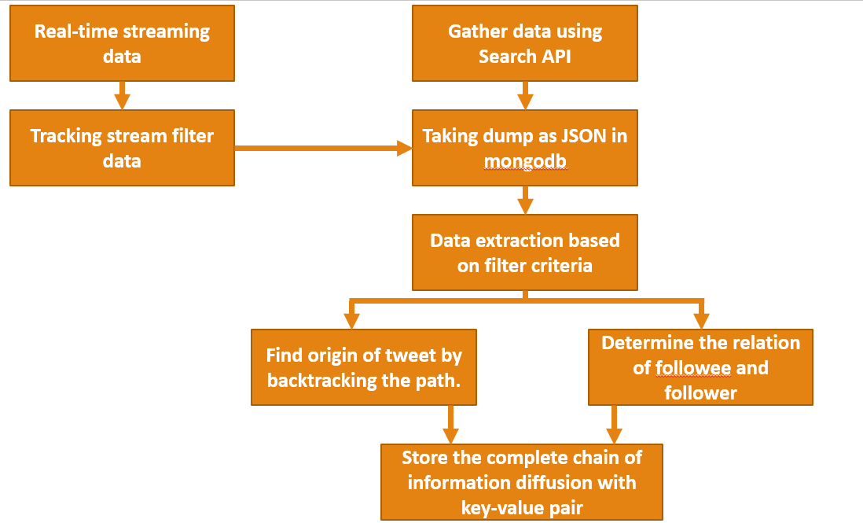
Proposed Methodology

Slide 7
References
[1] Guille A, Hacid H, Favre C, Zighed DA (2013) Information diffusion in online social networks: a survey. SIGMOD Rec 42(1):17–28.
[2] Geerajit Rattanaritnont, Masashi Toyoda, Masaru Kitsuregawa, “Characterizing Topic-Specific Hashtag Cascade in Twitter Based on Distributions of User Influence”, Web Technologies and Applications. APWeb 2012. Lecture Notes in Computer Science, vol 7235. Springer, Berlin, Heidelberg.
[3] Kai Zhang, Jingjing Wang, Chunxiao Jiang, Zhongxiang Wei, Yong Ren, ”Big data driven information diffusion analysis and control in online social networks.”, in IEEE International Conference on Communications ,2017.
[4] L. Dickens, I. Molloy, J. Lobo, P. C. Cheng, A. Russo, “Learning stochastic models of information flow”, IEEE 28th International Conference on Data Engineering, pp. 570–581, 2012.
[5] L. Weng, J. Ratkiewicz, N. Perra, B. Gon¸calves, C. Castillo, F. Bonchi, R. Schifanella, F. Menczer, A. Flammini, “The role of information diffusion in the evolution of social networks”, Proceedings of the 19th ACM SIGKDD International Conference on Knowledge Discovery and Data Mining, KDD ’13, ACM, pp. 356–364, 2013.
[6] Yadong Zhou, Beibei Zhang, Xiaoxiao Sun, Qinghua Zheng, Ting Liu, “Analyzing and modeling dynamics of information diffusion in microblogging social network”, Journal of Network and Computer Applications 86: 92-102, 2017.

Slide 8

Thank You !!

